Slide 1
Recurrent Neural Network

Slide 2
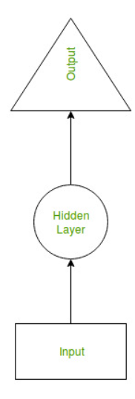
Recurrent Neural Network(RNN) is a type of Neural Network where the output from the previous step is fed as input to the current step. In traditional neural networks, all the inputs and outputs are independent of each other, but in cases like when it is required to predict the next word of a sentence, the previous words are required and hence there is a need to remember the previous words. Thus RNN came into existence, which solved this issue with the help of a Hidden Layer. The main and most important feature of RNN is the Hidden state, which remembers some information about a sequence.

Slide 3
RNNs have a “memory” which remembers all information about what has been calculated. It uses the same parameters for each input, performing the same task on all the inputs or hidden layers to produce the output. This reduces the complexity of parameters, unlike other neural networks.
Although the basic Recurrent Neural Network is fairly effective, it can suffer from a significant problem.
For deep networks,
The Back-Propagation process can lead to the following issues:- Vanishing Gradients: This occurs when the gradients become very small and tend towards zero.
Exploding Gradients: This occurs when the gradients become too large due to back-propagation.
The problem of Exploding Gradients may be solved by using a hack – By putting a threshold on the gradients being passed back in time. But this solution is not seen as a solution to the problem and may also reduce the efficiency of the network. To deal with such problems, two main variants of Recurrent Neural Networks were developed – Long Short Term Memory Networks and Gated Recurrent Unit Networks.

Slide 4
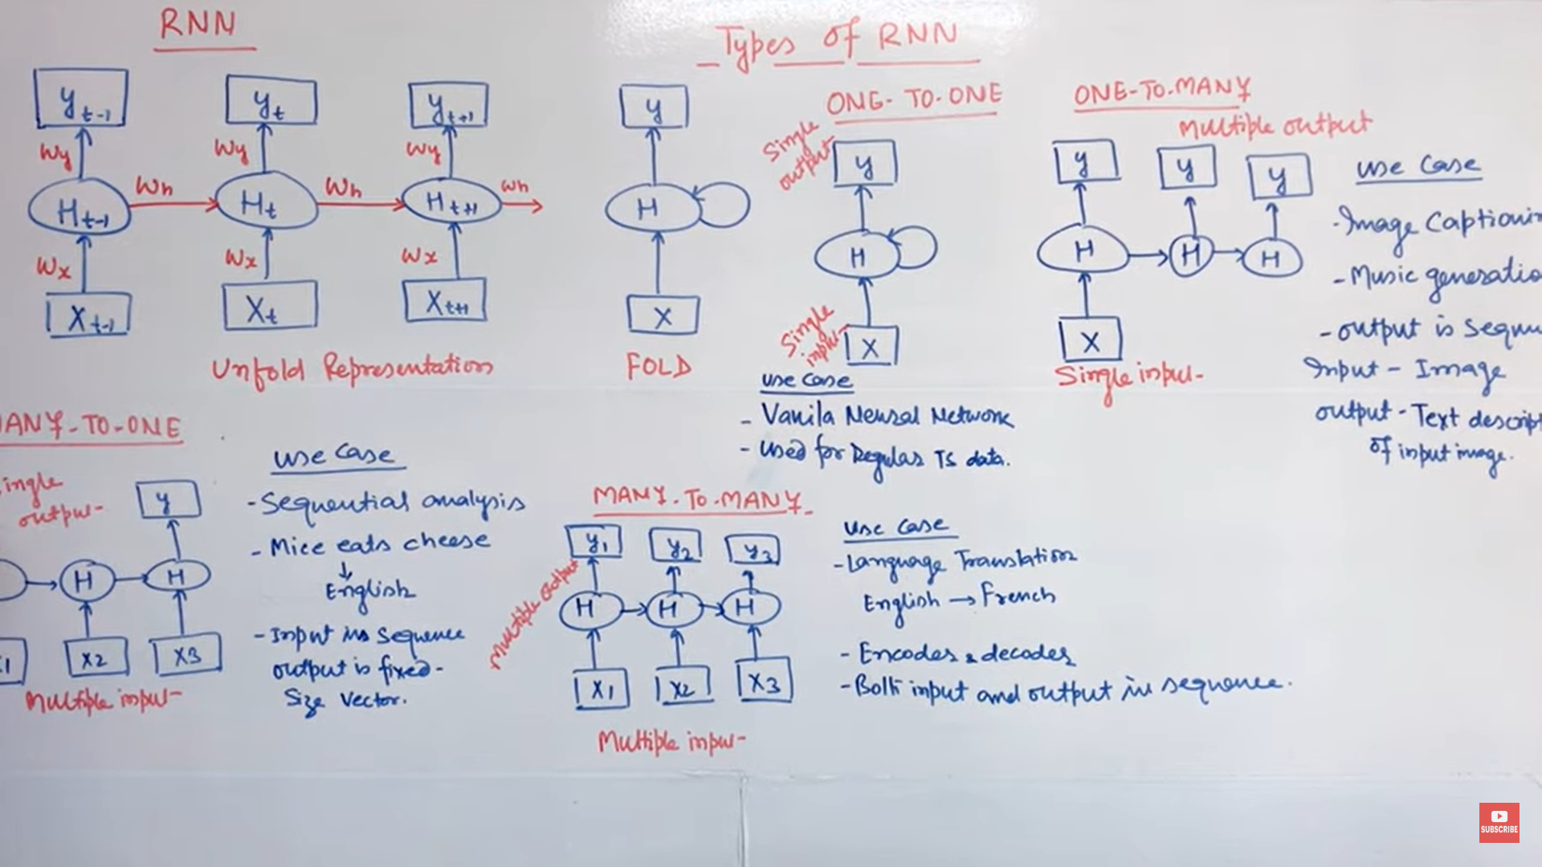

Slide 5
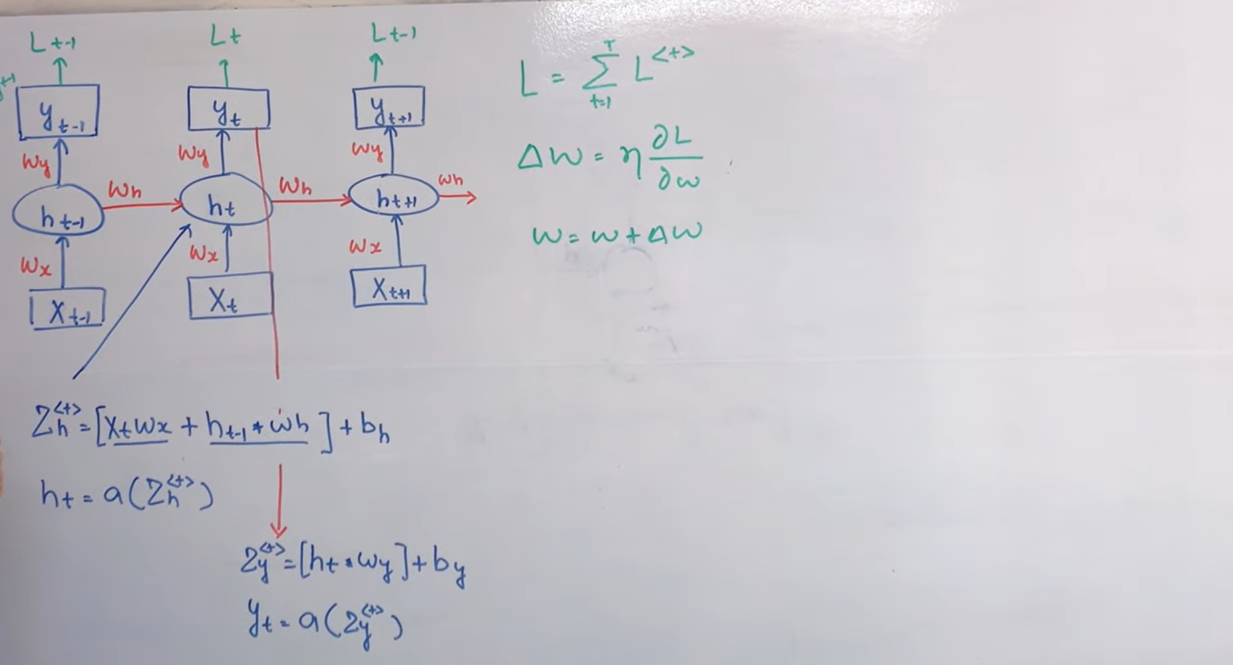

Slide 6
Advantages of Recurrent Neural Network
An RNN remembers each and every piece of information through time. It is useful in time series prediction only because of the feature to remember previous inputs as well. This is called Long Short Term Memory.
Recurrent neural networks are even used with convolutional layers to extend the effective pixel neighborhood.
Disadvantages of Recurrent Neural Network
Gradient vanishing and exploding problems.
Training an RNN is a very difficult task.
It cannot process very long sequences if using tanh or relu as an activation function.

Slide 7
Applications of Recurrent Neural Network
Language Modelling and Generating Text.
Speech Recognition.
Machine Translation.
Image Recognition, Face detection
Time Series Forecasting.

Slide 8
Long Short-Term Memory Network
To solve the problem of Vanishing and Exploding Gradients in a Deep Recurrent Neural Network, many variations were developed. One of the most famous of them is the Long Short-Term Memory Network(LSTM). In concept, an LSTM recurrent unit tries to “remember” all the past knowledge that the network is seen so far and to “forget” irrelevant data. This is done by introducing different activation function layers called “gates” for different purposes. Each LSTM recurrent unit also maintains a vector called the Internal Cell State which conceptually describes the information that was chosen to be retained by the previous LSTM recurrent unit.
LSTM networks are the most commonly used variation of Recurrent Neural Networks (RNNs). The critical component of the LSTM is the memory cell and the gates (including the forget gate but also the input gate), inner contents of the memory cell are modulated by the input gates and forget gates. Assuming that both of the segues are closed, the contents of the memory cell will remain unmodified between one time-step and the next gradient gating structure allowing information to be retained across many time steps, and consequently also allowing the group to flow across many time steps. This allows the LSTM model to overcome the vanishing gradient properly that occurs with most Recurrent Neural Network models.
A Long Short Term Memory Network consists of four different gates for different purposes as described below:-

Slide 9
Forget Gate(f): At forget gate the input is combined with the previous output to generate a fraction between 0 and 1, which determines how much of the previous state needs to be preserved (or in other words, how much of the state should be forgotten). This output is then multiplied by the previous state. Note: An activation output of 1.0 means “remember everything” and an activation output of 0.0 means “forget everything.” From a different perspective, a better name for the forget gate might be the “remember gate”
Input Gate(i): The input gate operates on the same signals as the forget gate, but here the objective is to decide which new information is going to enter the state of LSTM. The output of the input gate (again a fraction between 0 and 1) is multiplied by the output of the tan h block that produces the new values that must be added to the previous state. This gated vector is then added to the previous state to generate the current state
Input Modulation Gate(g): It is often considered as a sub-part of the input gate and much literature on LSTMs does not even mention it and assumes it is inside the Input gate. It is used to modulate the information that the Input gate will write onto the Internal State Cell by adding non-linearity to the information and making the information Zero-mean. This is done to reduce the learning time as Zero-mean input has faster convergence. Although this gate’s actions are less important than the others and are often treated as a finesse-providing concept, it is good practice to include this gate in the structure of the LSTM unit.

Slide 10
4. Output Gate(o): At the output gate, the input and previous state are gated as before to generate another scaling fraction that is combined with the output of the block that brings the current state. This output is then given out. The output and state are fed back into the LSTM block
Working of an LSTM recurrent unit:
Take input the current input, the previous hidden state, and the previous internal cell state.
Calculate the values of the four different gates by following the below steps:-
For each gate, calculate the parameterized vectors for the current input and the previous hidden state by element-wise multiplication with the concerned vector with the respective weights for each gate.
Apply the respective activation function for each gate element-wise on the parameterized vectors. Below given is the list of the gates with the activation function to be applied for the gate.
Calculate the current internal cell state by first calculating the element-wise multiplication vector of the input gate and the input modulation gate, then calculate the element-wise multiplication vector of the forget gate and the previous internal cell state and then add the two vectors.
Calculate the current hidden state by first taking the element-wise hyperbolic tangent of the current internal cell state vector and then performing element-wise multiplication with the output gate.

Slide 11
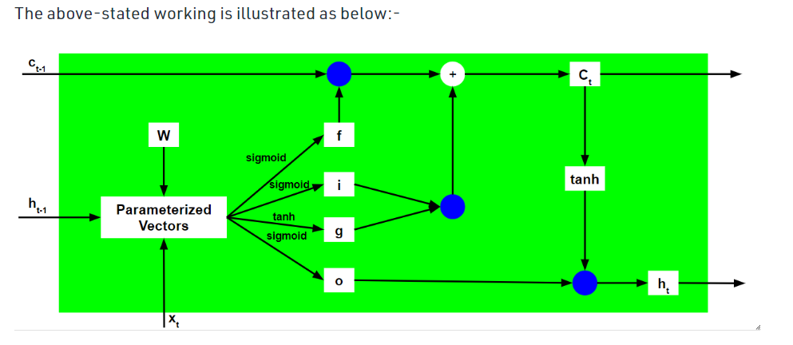

Slide 12


